Slide 1
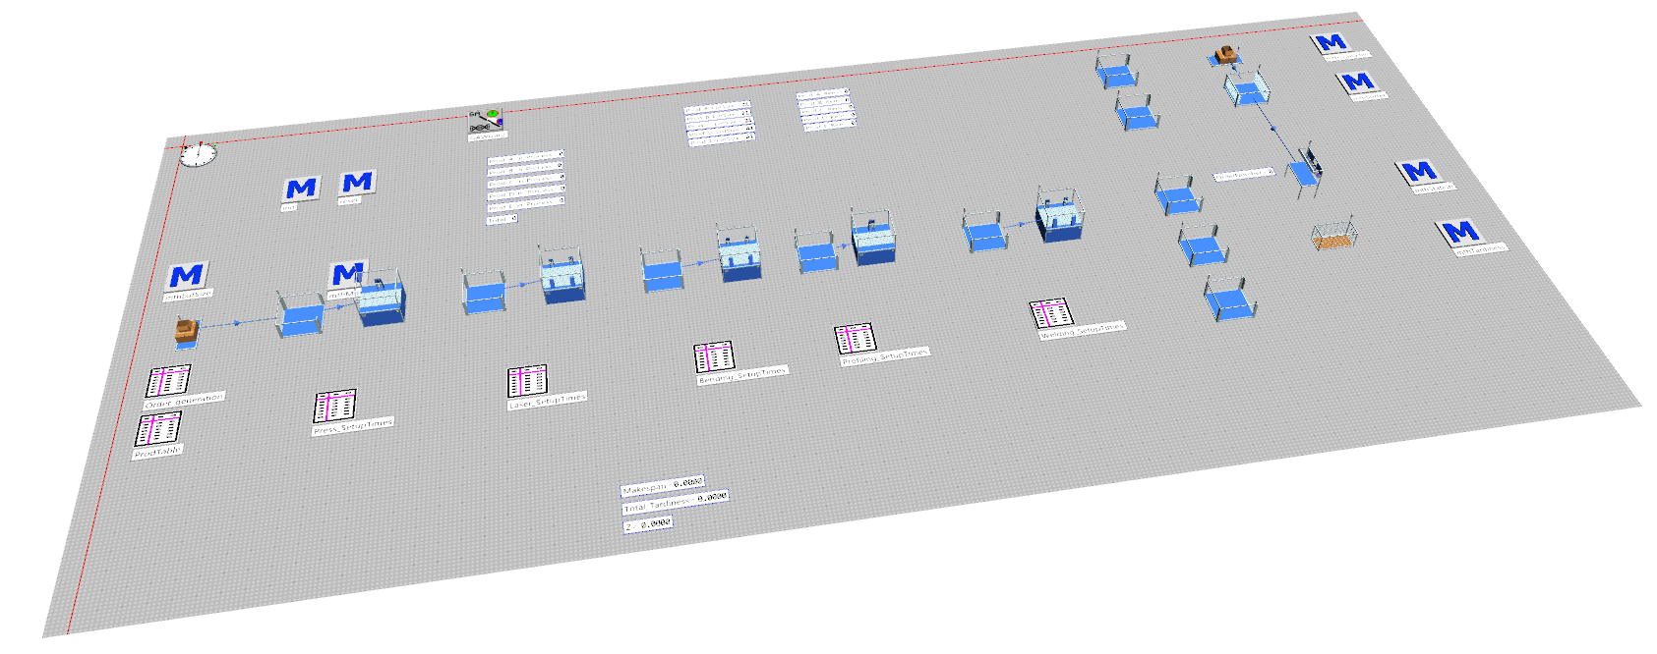

Production Planning Optimization using Technomatix Plant Simulation

Slide 2
Problem Statement
Delivery delays faced by a medium-sized Sub contracting company producing 5 types of products each with its own production sequence, processing and setup times.
Processing station : Pressing, Lasering, Bending, Profiling and Welding
Present condition : For 100 customer orders sum of all delays is 17days.
Objective
To improve delivery reliability by changing production sequence of customer orders and by changing the lot sizes.
Methodology
Discrete-event simulation and genetic algorithm optimization using Technomatix plant simulation.

Slide 3
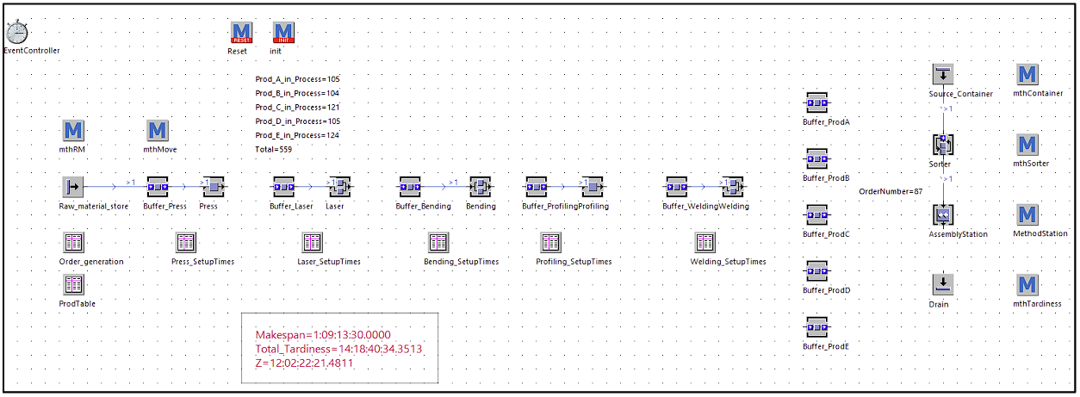
Task 1: Initial Material flow model development
An initial material flow model to serve as a baseline for subsequent optimization was created.
Used init method to generate 100 random orders with random no. of product types.
Initial production sequence : Alphabetical order of product types ( A to E )
Calculated Makespan (Total time required to process all orders) and Total tardiness (Sum of all delays).

Slide 4
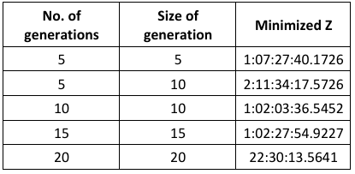
Task 2: Optimization with Genetic algorithm
To minimize the Makespan and total tardiness according to given objective function GA wizard was used.
Product table and lot sizes were given as optimization parameters and bounds were defined.
The simulation was run with experimentally suitable parameters for no. of generations and size of generations.

Slide 5
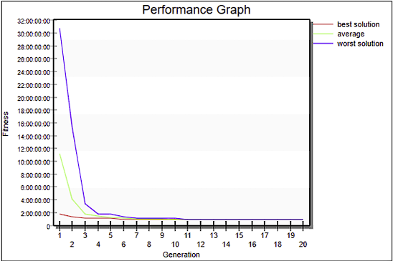
Result
The genetic algorithm optimized the problem by minimizing the objective function.
The GA optimized both production sequence and lot sizes given as optimization parameter to reduce the fitness value from 17 days to 22 hours.
Optimized production sequence : ProductB > ProductA > ProductC > ProductE > ProductD
Fig. Example Evolution of the fitness values of the generations

Slide 6
Discrete-Rate and Discrete-Event Simulation Modelling in Production planning

Slide 7
Problem Statement
Optimizing production processes in a cookie factory using simulation models.
Objective
Identify bottlenecks and estimate production capacity over two weeks..
Methodology
Discrete-Rate Simulation (DRS) and Discrete-Event Simulation (DES) in ExtendSim.

Slide 8
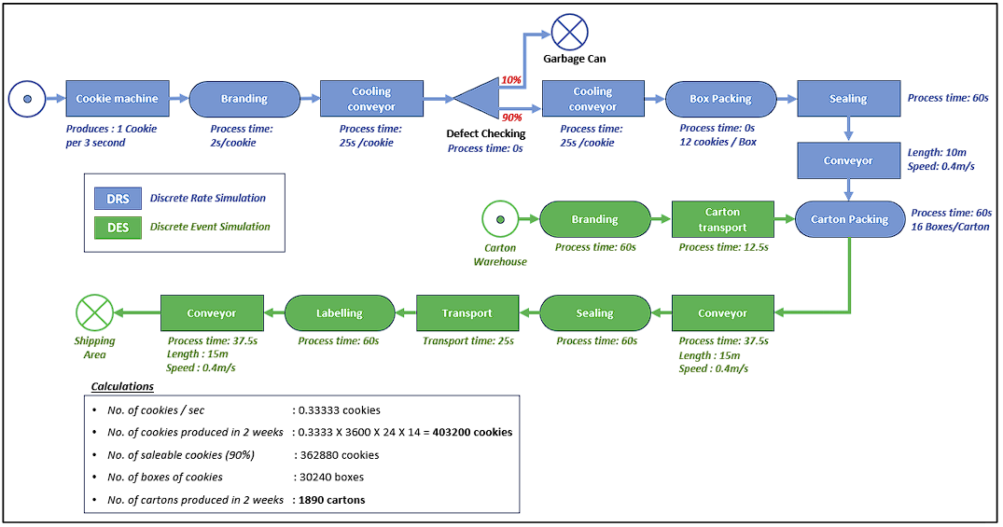
Task 1: Conceptual Model
Developed a conceptual model for the process and made rough calculations for expected throughput.
Selected modelling technique to be used for different processes involved.

Slide 9
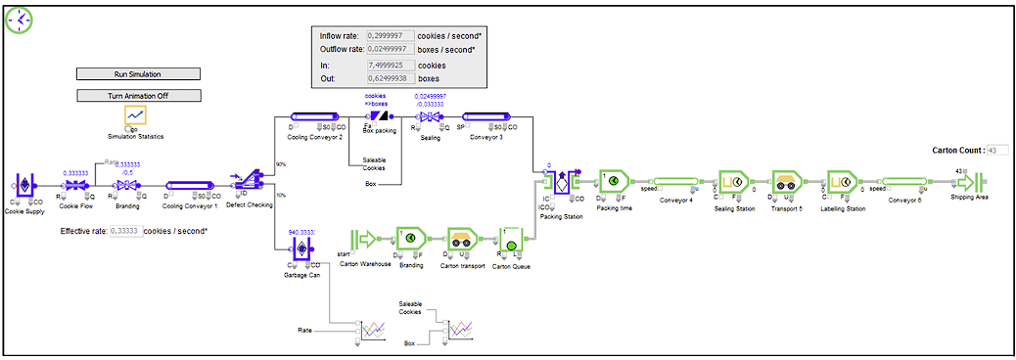
Task 2: Modelling and Simulation in ExtendSim
The production process based on selected modelling techniques were modelled.
The simulation was run for 2 weeks to determine the throughput.
Bottleneck analysis for all the processes were carried out based utilization at different stages.
Result of rough and simulated calculation were compared.

Slide 10
Conclusion
Both of these projects helped me understand how material flow simulation can significantly improve production planning efficiency and delivery reliability.
Demonstrated the effectiveness of simulation and practical applications of these techniques in enhancing manufacturing processes.

